Slide 1

Clarusway Group Mentoring
(Week 5)

Slide 2


Slide 3
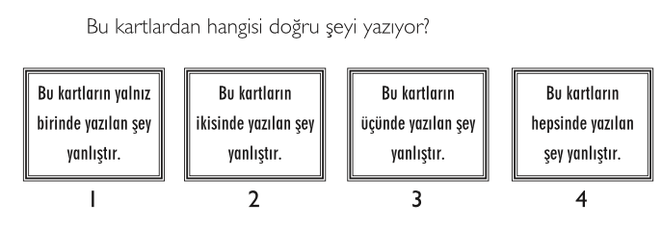
WARM UP QUESTIONS

Slide 4
QUESTIONS
What is Python?
What is PEP 8?
Aşağıdakilerden hangileri PEP 8 convention ‘a göre doğrudur
A B
I. print('continent') print ('continent')
II. if y == 3 : print x , y ; x , y = y , x if y == 3: print x, y; x, y = y, x
III. df[0,] or foo = (2,) df[0, ] or foo = (2, )

Slide 5
QUESTIONS
What are the comments and how do you write it in Python?
Why does giving variable name and write comment on your code are so important?

Slide 6
QUESTIONS
What are the numerical data types in Python and their properties?
Describe the Boolean types in detail.

Slide 7
QUESTIONS
6. Aşağıdaki kodların çıktıları nedir?
print(type(32.6))
print(type(True))
print(type(‘True’))
print(type(‘56.8’))
print(type(3+4j))

Slide 8
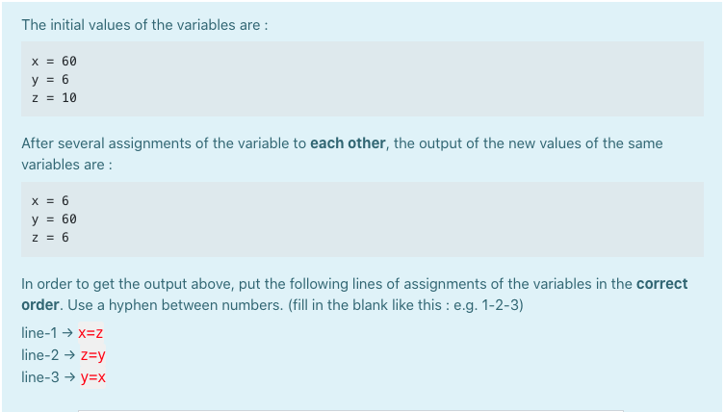
QUESTIONS
Uygulanacak dönüşümün sırasını yazınız

Slide 9
QUESTIONS
What is an issue in JIRA Software?
List and briefly describe the issues types in Jira Software.

Slide 10
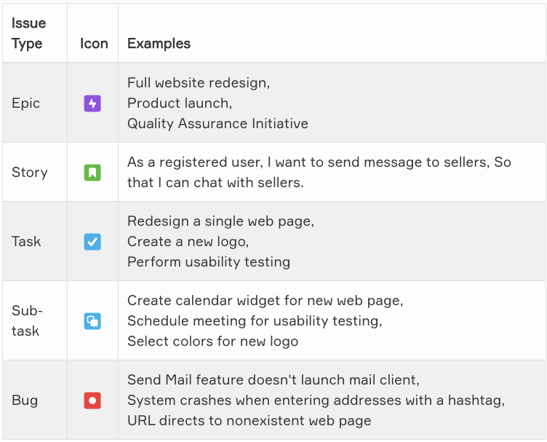
QUESTIONS

Slide 11
ADVICE FROM CLARUSWAY
Is there anything distracting you?
https://www.lifehack.org/articles/productivity/10-critical-tips-prevent-distraction-and-sharpen-your-focus.html

Slide 12

CLARUSWAY
YOUR QUESTIONS?

